Slide 1

BINSIGHT: SMART WASTE SEGREGATION WITH SECURITY CAMERS
CYB23IN101 Internship -I
Final Review
Date: 10-7-2026
Team Members
1.Balavignesh K (E0225002)
2.Askwanth Kumar (E0225007)
3.Daniel Mark Rowland (E0225003)
Project Guide
Dr G Jayanthi,
Associate Professor and Senior IEEE member
Cyb/IOT

Slide 2

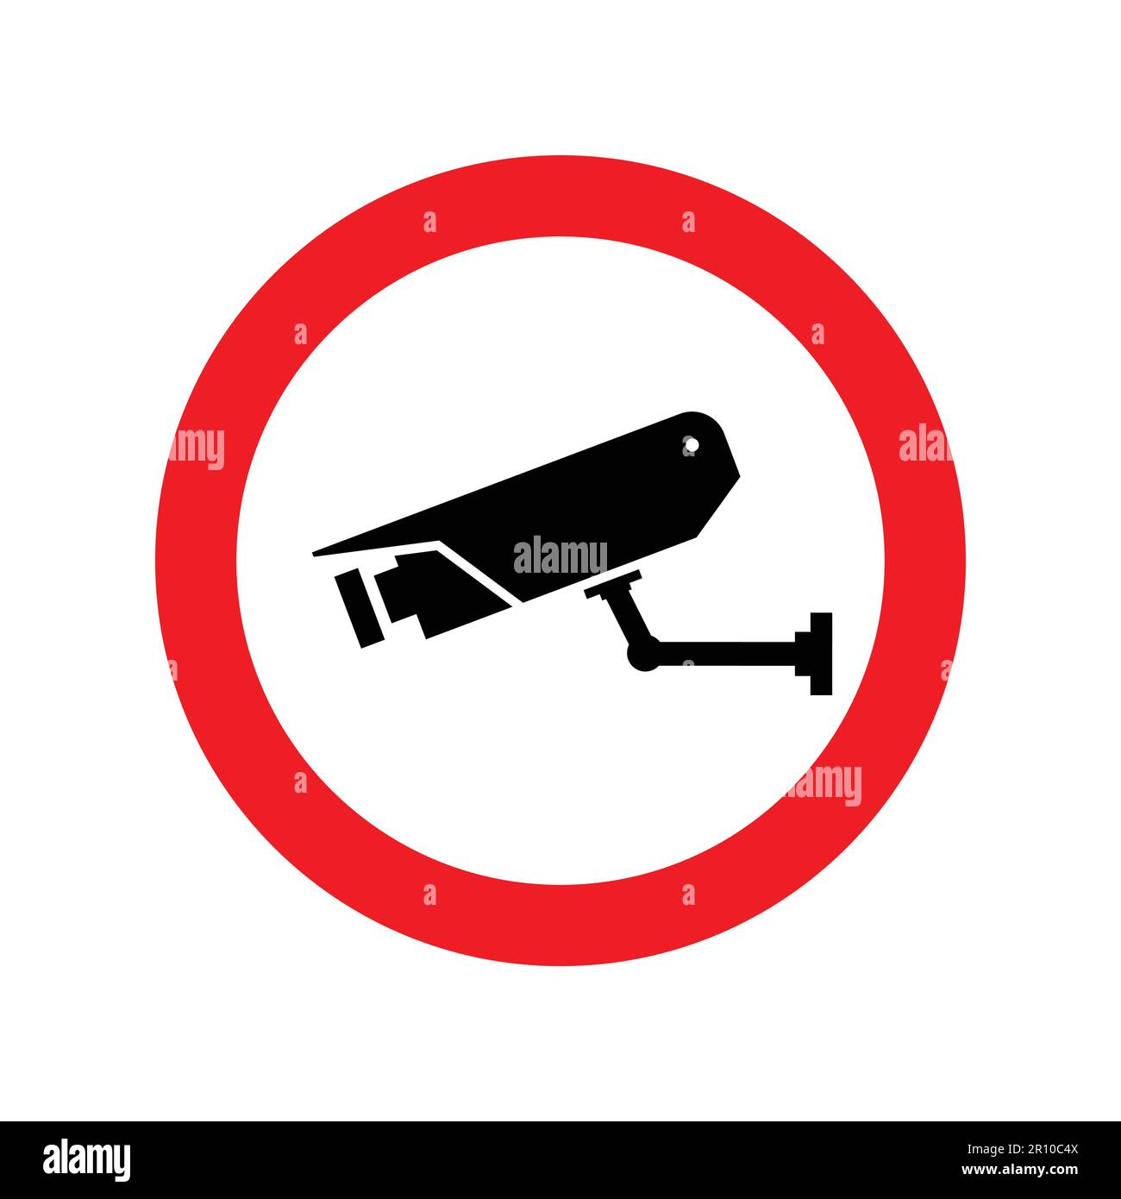
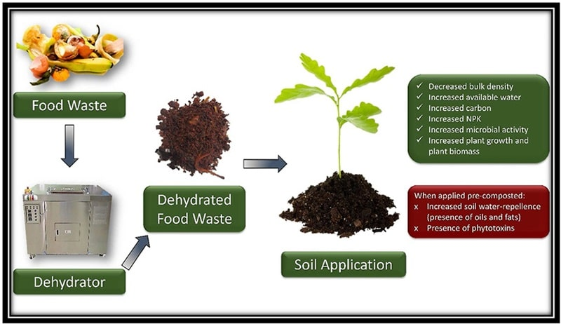
INTRODUCTION
Need for the technology: Combining Cleanliness and Security
Applications: Household & Kitchen Waste segregation & security
Motivation behind the study: To create a clean & safe house
Challenges to be addressed: 1. Dependency on a Local PC (The Edge Server)
2. Camera Lens Obscuration & Maintenance
3. The "Opaque Bag" Problem (Waste Encapsulation)
4. Mechanical Jamming & Weight Limits

Slide 3
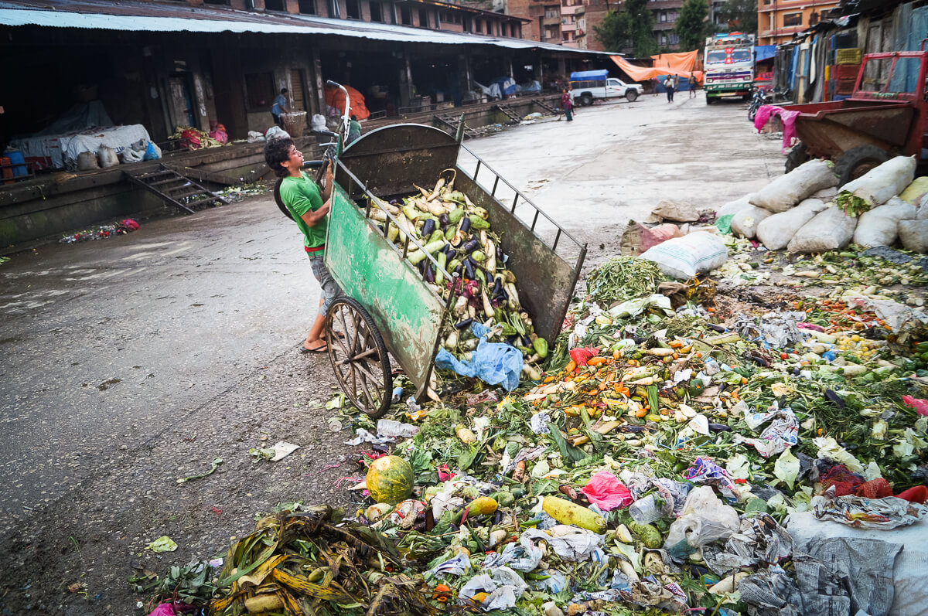
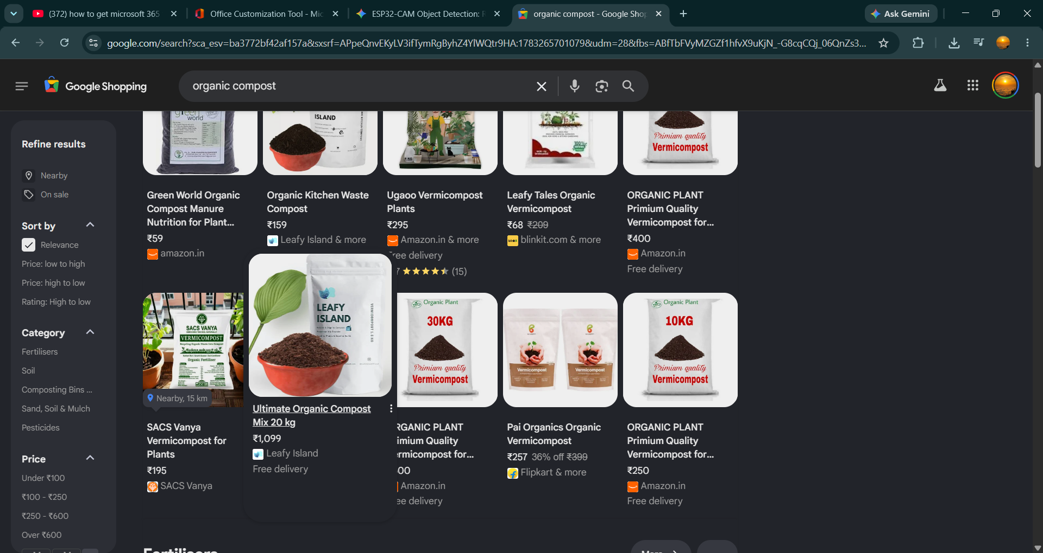
This is the current situation of India where waste not disposed properly:
Through Separating organic biodegradable waste from kitchen and house hold and converting them to high quality manure has a lot of advantages, like it is a product through which we can earn money, also keeps our house and environment clean and safe (safe from small bacteria to criminals)
Money making options
PSB (Phosphate-Solubilizing Bacteria) can be used to smell free decomposition
10 July 2026

Slide 4
REVIEW OF LITERATURE
Author and Year (chronological order) | Methodology/ Materials and Methods | Datasets | Results/Outcome | Advantage / Key findings from the work | Disadvantage/ GAP Identified from the work
Costa et al. (2019) | Smart bin using Arduino and ultrasonic sensors | Sensor data | Accurate measurement of waste levels | Low power consumption and cost-effective monitoring | Lacks image-based waste classification
Adedeji & Wang (2020) | Deep learning using transfer learning (ResNet50) | Public waste image dataset | Improved waste recognition accuracy | Reduces manual sorting | Requires a large training dataset
Rad et al. (2020) | IoT smart bin with ultrasonic sensor | Sensor data | Real-time bin-level monitoring | Prevents bin overflow | No automatic waste segregation
Chu et al. (2021) | Raspberry Pi with camera and CNN | Waste image dataset | Automated waste classification | Low-cost embedded solution | Slower processing compared to high-end systems
Kumar & Patel (2021) | ESP32-CAM images processed via AWS Cloud | Custom local dataset | Successful remote inference with 2-3 seconds latency | Very low-cost hardware utilizing ESP32-CAM | Cloud dependency introduces latency and requires internet
Li et al. (2022) | YOLO object detection for waste sorting | Garbage classification dataset | Fast real-time waste detection | Suitable for embedded AI systems | Sensitive to camera angle and occlusion
Rahman et al. (2022) | ESP32 smart bin with IoT monitoring | Real-time sensor readings | Remote monitoring through cloud platform | Efficient collection management | Depends on stable internet connection
Zhang et al. (2023) | Deep learning with YOLOv7 for waste detection | Open-source waste dataset | High detection speed and accuracy | Real-time object detection | Requires GPU for model training
Chen et al. (2023) | Computer vision and robotic arm for waste sorting | Mixed waste dataset | Automated sorting with robotic assistance | High sorting efficiency | High implementation cost
Singh & Gupta (2024) | Edge AI YOLOv8 model communicating with ESP32-CAM and PIR | Custom Roboflow annotated dataset | Ultra-low latency segregation and motion detection | Bypasses cloud costs and integrates surveillance | Relies on local PC/Server to remain active

Slide 5
PROBLEM STATEMENT
Current smart waste bins fail to leverage their built-in cameras for secondary functions, leaving expensive hardware sitting uselessly idle for most of the day.
The Brains (AI): A local Python server uses custom trained YOLOv8 to instantly classify type of waste from images.
The Body (Hardware): An ESP32-CAM captures photos, tilts a servo
motor to sort the trash, and uses a PIR sensor to detect motion (while in surveillance mode.
The Communication: The camera and server talk over local Wi-Fi using
HTTP over FTP(sending images) and JSON (receiving type of waste & servo commands).
The Security Alert: When motion is detected, the ESP32 bypasses the local
server and sends a photo securely over HTTPS to the Telegram Bot API.
The Brain Switch: A Finite State Machine (FSM) algorithm uses a physical
push-button to instantly flip the system's behavior between "Smart Bin"
mode and "Surveillance" mode.

Slide 6
MODULES
# | Modules | Methodology/ Algorithm | Technologies (H/W and S/W) | Implementation
1 | Dual-State Controller | Finite State Machine & Debouncing | H/W: ESP32-CAM, Button S/W: Arduino C++ | Toggles the system between Bin and Surveillance modes via a button press.
2 | Edge-AI Vision | YOLOv8 (CNN) | H/W: PC Server S/W: Python, FastAPI, custom trained YOLOv8 model | Analyzes incoming images locally to instantly classify waste types offline.
3 | Automated Sorting | JSON Parsing & PWM Control | H/W: Servo Motors S/W: Arduino C++ | Converts AI classification data into physical servo movements to route the trash.
4 | Motion Detection | PIR Sensing | H/W: PIR Sensor S/W: C++ Digital I/O | Detects human heat signatures to trigger the camera when in security mode.
5 | Secure Alerts | HTTPS Data Streaming | H/W: Wi-Fi, Smartphone S/W: Telegram Bot API | Bypasses the local server to send instant intruder photo alerts to the user's phone.

Slide 7
OBJECTIVES
Deploy Local Edge-AI:
Use Custom trained YOLOv8 model for instant, offline waste classification.
Automate Physical Sorting:
Control servo motors via an ESP32-CAM & flask server to route trash.
Integrate Security Alerts:
Send PIR motion-triggered photos to Telegram over Wi-Fi.
Implement Mode Switching:
Use a physical button to toggle between Bin and Surveillance modes.
Maximize Hardware Utility:
Eliminate idle time by giving the camera a dual purpose.

Slide 8
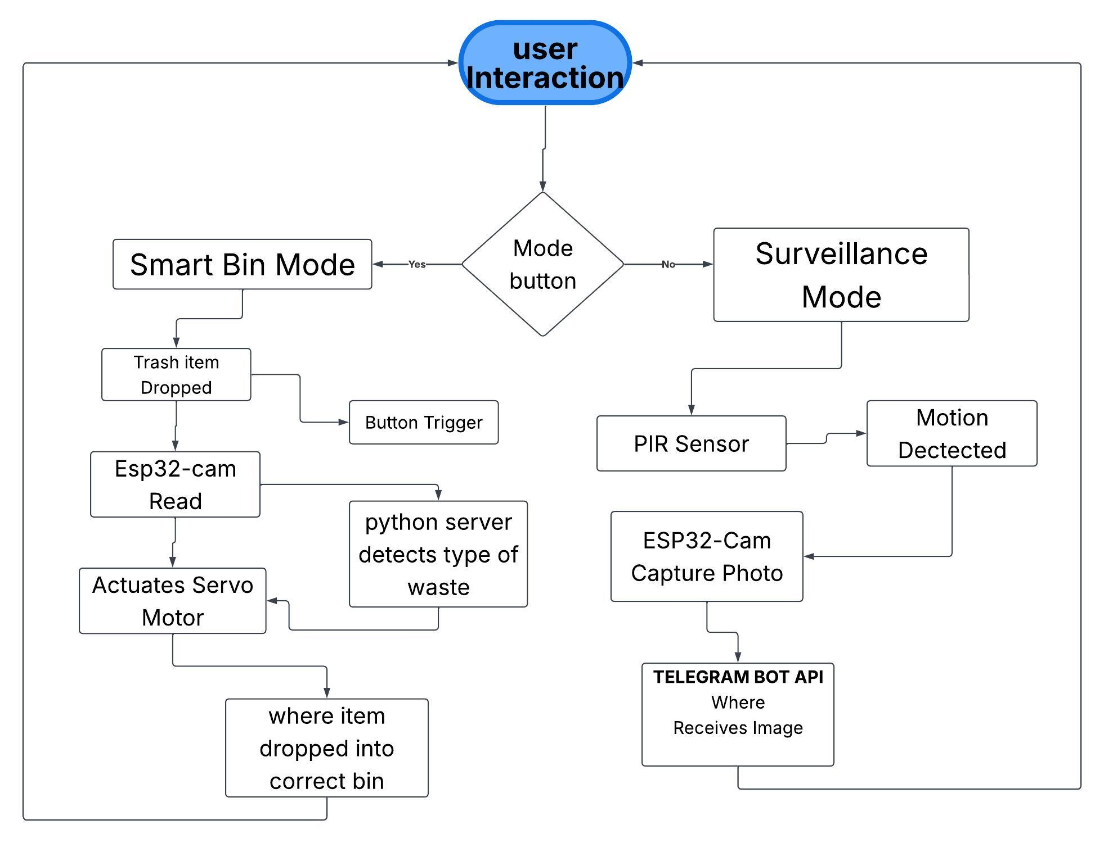
WORKFLOW DIAGRAM
Objective 1
Objective 2
Objective 3
Objective 4
Objective 5

Slide 9
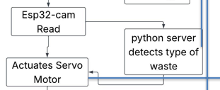
Methodology
Objective 1: Deploy Local Edge-AI
Proof of Concept: Verifying that a lightweight AI model can classify waste using images captured directly from a low-power microcontroller without relying on cloud processing.
Formulation of Methods/Algorithm: Training a YOLOv8 Nano model on a custom waste dataset using Roboflow, and scripting a local Python Flask server to decode raw JPEG byte streams into OpenCV matrices for ultra-low latency inference.
Prototype Design and Implementation: Setting up a local PC/laptop as the Edge Server running the server.py script on port 5000, and configuring the ESP32-CAM to transmit frames to this specific local IP address over HTTP.
Working Model: A live OpenCV video window running on the local PC, instantly drawing bounding boxes around waste items (i.e., “non-biodegradable", “biodegradable") held in front of the ESP32 camera lens.

Slide 10
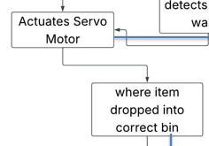
Methodology
Objective 2: Automate Physical Sorting
Proof of Concept: Demonstrating that AI classification results can be translated into physical, electromechanical movement to segregate waste automatically.
Formulation of Methods/Algorithm: Developing a substring-matching algorithm on the Python server to map detected classes to specific servo angles (e.g., Biodegradable = 30°, Non-biodegradable = 150°), and transmitting this as a JSON payload.
Prototype Design and Implementation: Wiring an SG90/MG996R servo motor to GPIO 14 of the ESP32-CAM and using the ledcWrite PWM function to rotate a physical trapdoor mechanism based on the parsed JSON response.
Working Model: A physical smart bin prototype where dropping a plastic bottle causes the internal flap to physically tilt to the right, depositing the item into the non-biodegradable compartment before resetting.

Slide 11
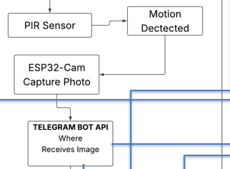
Methodology
Objective 3: Integrate Security Alerts
Proof of Concept: Validating that the ESP32-CAM can process hardware sensor interrupts and establish secure external network connections despite its limited SRAM.
Formulation of Methods/Algorithm: Utilizing the Telegram Bot API (api.telegram.org) via an HTTPS POST request, breaking the captured image buffer into 1024-byte chunks to prevent memory overflow during multi-part form data transmission.
Prototype Design and Implementation: Wiring an HC-SR501 PIR motion sensor to GPIO 13, and coding the ESP32 to bypass SSL certificate validation (client.setInsecure()) to securely upload the photo alert to a specific Telegram Chat ID.
Working Model: The BinSight Telegram Bot application on a smartphone, immediately receiving a text alert and a clear photograph whenever motion is detected by the PIR sensor.

Slide 12
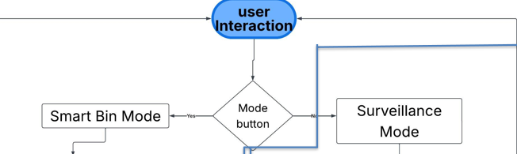
Methodology
Objective 4: Implement Mode Switching
Proof of Concept: Proving that the core functionality of the device can be manually overridden and swapped without requiring a hard reset or code re-upload.
Formulation of Methods/Algorithm: Utilizing a hardware-debounced Interrupt Service Routine (ISR) attached to a falling-edge trigger to safely toggle a global state variable between operational modes.
Prototype Design and Implementation: Connecting a physical push-button to GPIO 12 (using INPUT_PULLUP). Programming the ISR to switch between MODE_BIN and MODE_SURVEILLANCE, accompanied by 1 or 2 flashes of the built-in LED (GPIO 4) for visual user feedback.
Working Model: A physical control panel on the bin featuring a single button; pressing it instantly stops the local AI streaming and activates the PIR sensor, confirmed by the LED flash.

Slide 13
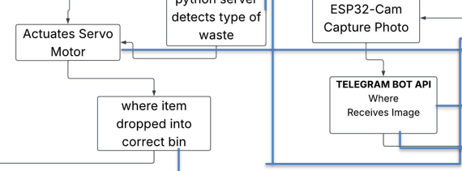
Methodology
Objective 5: Maximize Hardware Utility
Proof of Concept: Creating a single, unified codebase that allows an affordable IoT device to perform two vastly different tasks, eliminating idle time.
Formulation of Methods/Algorithm: Designing a Finite State Machine (FSM) within the main loop() of the ESP32 firmware. State A handles high-speed HTTP local streaming, while State B handles low-speed, interrupt-driven HTTPS remote alerts.
Prototype Design and Implementation: Consolidating the binsight_basic.ino and binsight_telegram.ino scripts into the final binsight_master.ino firmware, ensuring memory buffers are properly cleared when transitioning between states to prevent crashing.
Working Model: The finalized BinSight device, acting seamlessly as an AI waste sorter during daytime operations, and instantly transforming into an active security sentry during nighttime or off-hours via a simple button press.

Slide 14
Graphs
(ai model benchmarks from ultralytics)

Slide 15
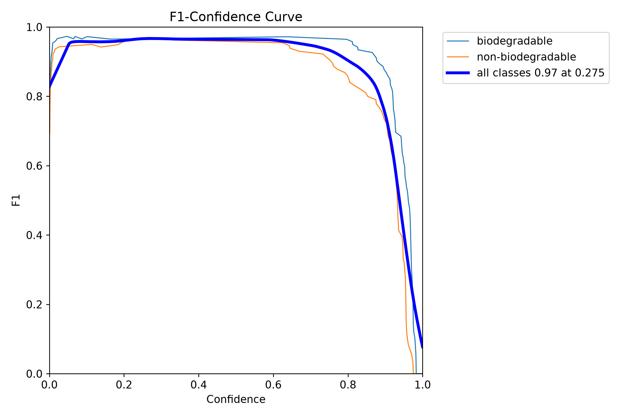
FI vs confidence graph

Slide 16
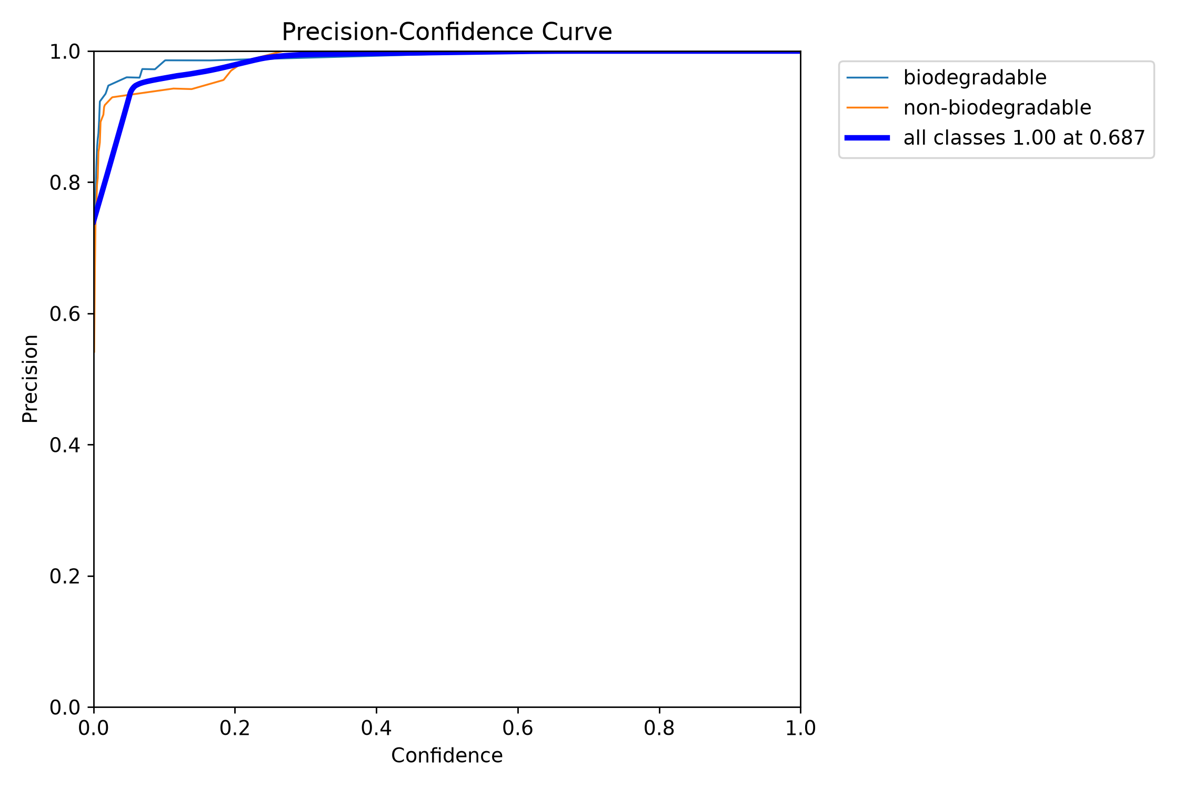
Precision vs confidence graph

Slide 17
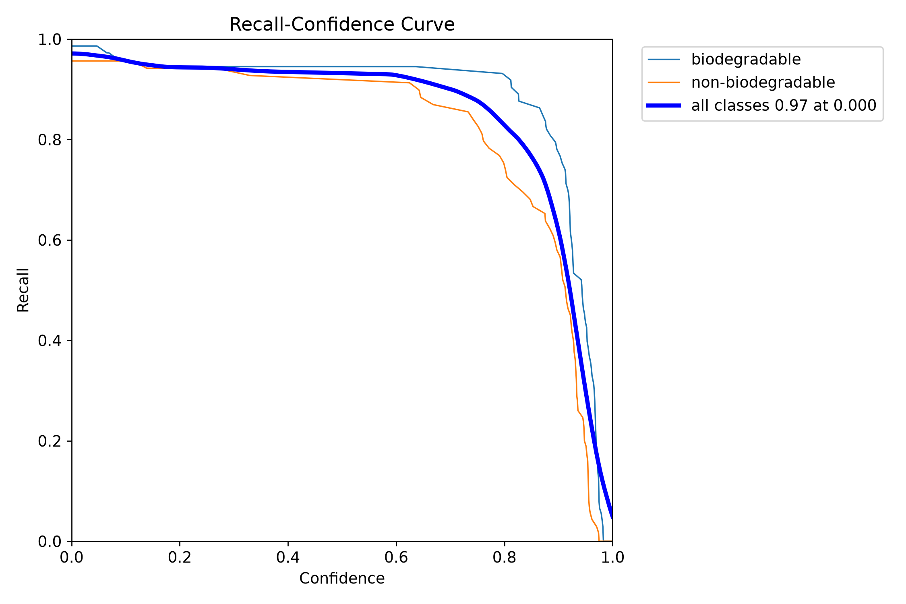
Recall vs confidence graph

Slide 18
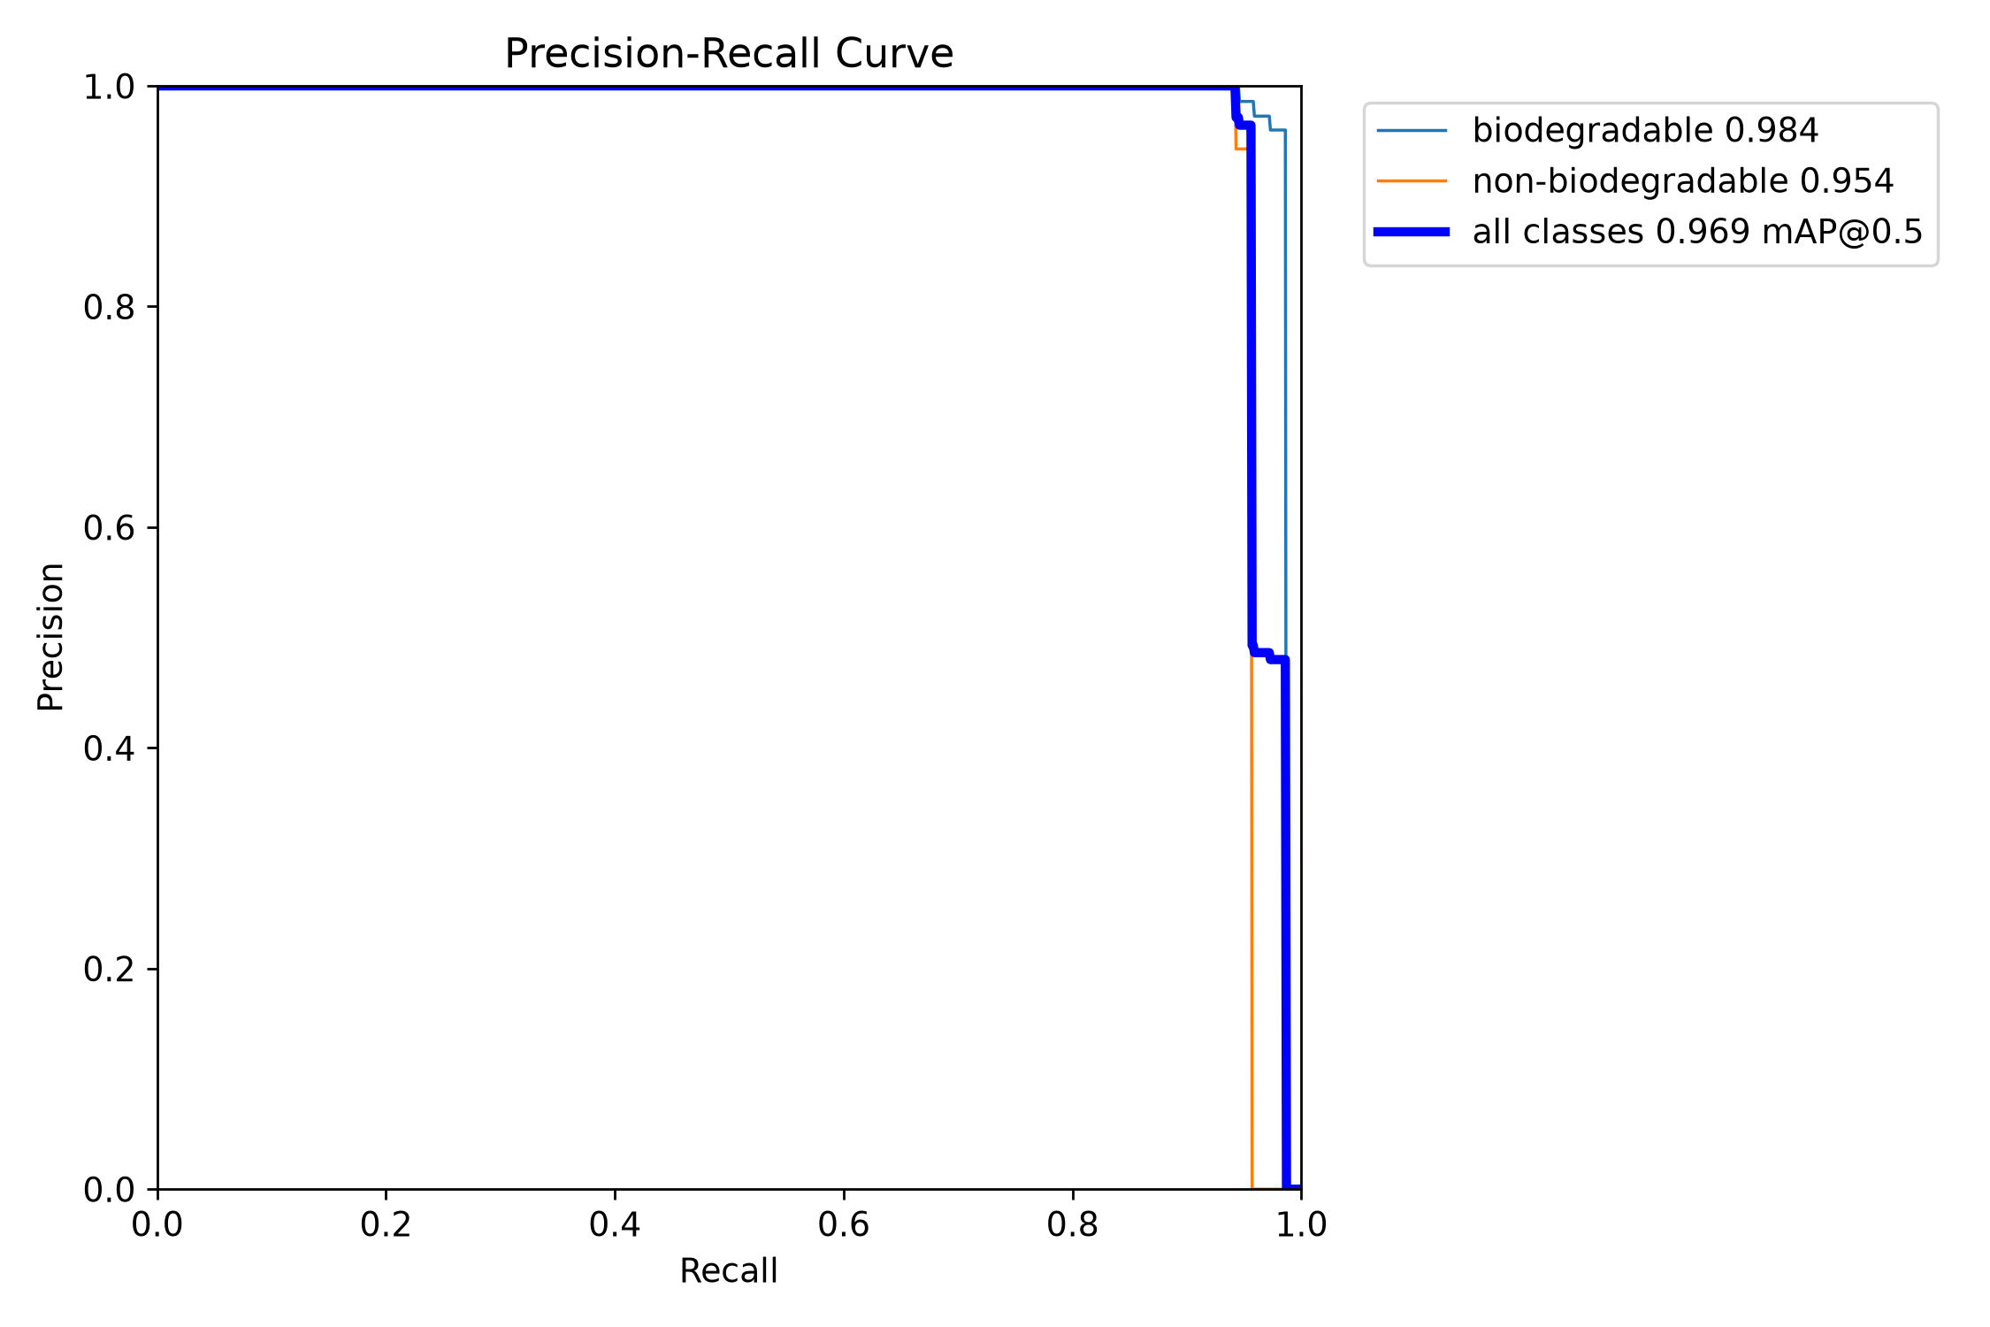
Precision vs recall graph

Slide 19
TENTATIVE RESULTS/ EXPECTED OUTCOME:
High-Accuracy Waste Classification: Achieve a high confidence rate (e.g., >90%) in identifying and distinguishing between targeted waste categories (plastic, cardboard, metal) using the custom-trained, local YOLOv8 neural network.
Ultra-Low Latency Edge Processing: Demonstrate near-zero latency (under 1 second) from the moment the ESP32-CAM captures the waste image to the physical actuation of the servo motor, proving the speed advantage of local edge-computing over cloud APIs.
Reliable Electromechanical Segregation: Successfully translate the Python server's JSON command payloads into precise PWM signals, resulting in an automated, error-free physical sorting mechanism that routes the recognized item into the correct physical bin.
Instant Security Threat Transmission: Establish a stable, secure HTTPS connection that successfully captures a high-resolution image upon PIR motion detection and delivers it as an instant Telegram alert to the user's smartphone within seconds.
Seamless System State Toggling: Validate the Finite State Machine (FSM) logic by demonstrating stable, hardware-debounced switching between Smart Bin Mode and Surveillance Mode without requiring system reboots, thereby proving the dual-utility value of the hardware.

Slide 20
CONCLUSION
Zero-Latency Edge AI: Proved that running YOLOv8 on a local server eliminates expensive cloud dependency and provides instant, real-time processing.
Automated Segregation: Successfully removed human error from recycling by using AI-driven servo motors to physically sort waste automatically.
Dual-Functionality (FSM): Maximized hardware utility by using a physical toggle to seamlessly switch the device from a waste bin into a security camera.
Secure Remote Alerts: Validated the ESP32-CAM’s ability to securely detect motion and transmit photographic intruder alerts instantly to Telegram.
Cost-Effective Scalability: Demonstrated that combining off-the-shelf IoT components creates a highly affordable, scalable solution for everyday consumer deployment.

Slide 21
EXPERIMENTAL EVALUATION
Computing Power/Configuration: ESP32-CAM microcontroller YOLOv8 model on a Flask server Arduino IDE and Python Wi-Fi connection for communication
Datasets Collected: Images of biodegradable and non-biodegradable waste Public waste image datasets and self-collected images Test images captured using the ESP32-CAM
Data Pre-processing: Resize images to the required input size Label images as biodegradable or non-biodegradable Normalize image data Remove blurred or duplicate images
Environmental Set-up for experiment and evaluation: Prototype tested in indoor conditions with adequate lighting Waste items placed individually into the smart bin ESP32-CAM captures images and sends them to the flask server

Slide 22
REFERENCES
[1] Y. Wang and H. Chen, "Real-time garbage classification on edge devices using YOLO algorithms," Sensors, vol. 23, no. 4, p. 1852, Feb 2023.
[2] S. Kumar, A. Singh, and P. Sharma, "IoT-based smart waste management system using ESP32-CAM and deep learning," 2022 Int. Conf. Smart Gener. Comput. (ICSGC), pp. 1-6, Oct 2022.
[3] G. Jocher, A. Chaurasia, and J. Qiu, "Ultralytics YOLOv8," GitHub repository, https://github.com/ultralytics/ultralytics, Jan 2023.
[4] R. Gupta, S. Verma, and V. Patel, "Low-cost smart surveillance system using ESP32-CAM and Telegram bot API," Int. J. Comput. Appl., vol. 178, no. 9, pp. 12-18, May 2021.
[5] D. Singh and P. Kumar, "Integrating IoT and motion sensors for smart security and automation," Smart Cities, vol. 6, no. 1, pp. 145-159, Jan 2023.
[6] A. Sharma and M. Desai, "Automated solid waste segregator using microcontrollers and servo mechanisms," J. Environ. Manage., vol. 261, p. 110245, May 2020.
[7] X. Li, Y. Zhang, and L. Wang, "Edge computing framework for computer vision applications in IoT environments," IEEE Access, vol. 10, pp. 45678-45689, Jun 2022.
[8] M. A. Rahman, A. T. Asyhari, and L. S. Leong, "Smart bin: Internet of Things-based real-time waste management system," Comput. Electr. Eng., vol. 92, p. 107125, Jun 2021.

Slide 23
WEB REFERENCES
[1] "Python for Data Science - Course for Beginners (Learn Python, Pandas, NumPy, Matplotlib)," freeCodeCamp.org, YouTube, https://www.youtube.com/watch?v=LHBE6Q9XlzI. [2] "Ultralytics YOLOv8 Documentation," Ultralytics, https://docs.ultralytics.com/.
[3] "Roboflow: Computer Vision Platform," Roboflow, https://roboflow.com/.
[4] "ESP32-CAM Video Streaming Web Server (works with Home Assistant)," Random Nerd Tutorials, https://randomnerdtutorials.com/esp32-cam-video-streaming-web-server-camera-home-assistant/.
[5] "Universal Telegram Bot Library for Arduino," Brian Lough, GitHub, https://github.com/witnessmenow/Universal-Arduino-Telegram-Bot.
[6] "ArduinoJson: Efficient JSON serialization for embedded C++," Benoit Blanchon, https://arduinojson.org/.

Slide 24
Thank you

